Slide 1
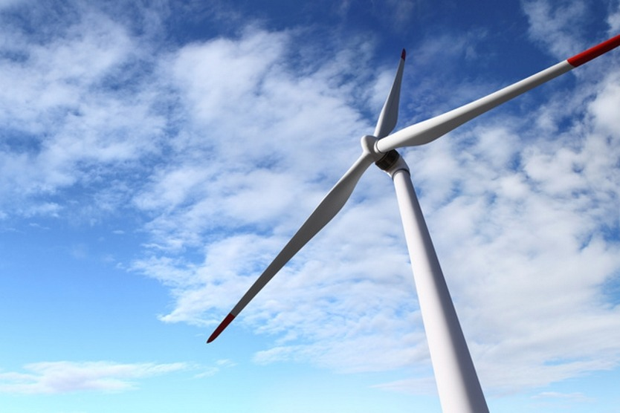
Energy transition the German experience
Ellen von Zitzewitz
German Embassy Moscow
March 22th 2018
IX International Forum Ecology

Slide 2
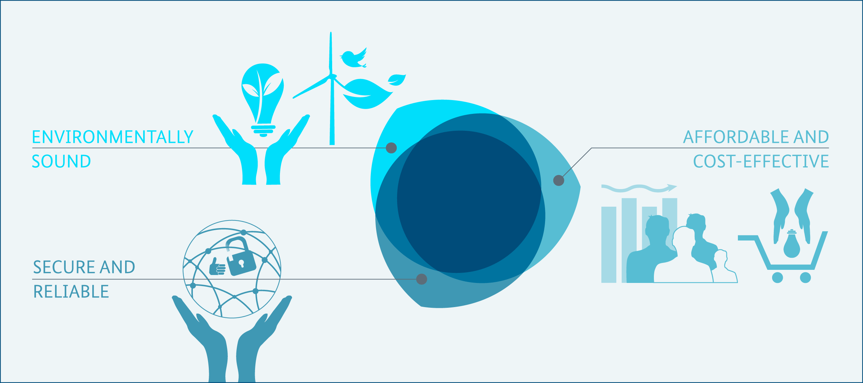
The triangle of energy policy objectives of the Energiewende
Security of supply, cost-effectiveness and environmental protection are interlinked.

Slide 3
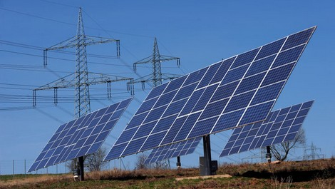
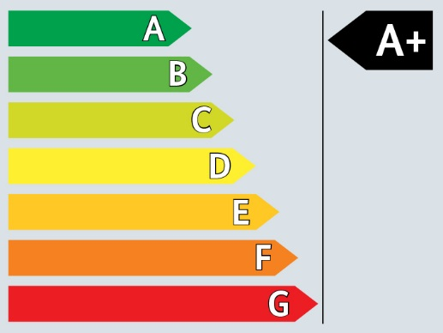
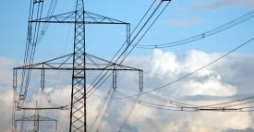
Pillars and action fields of the Energiewende
Supporting fields of action
Market and system integration
Renewable Energy
Energy Efficiency
Key legislation:
Renewable Energy Sources Act
Renewable Energy Heat Act
Key legislation:
Energy Saving Ordinance
Heating Cost Ordinance
Energy research and development
Steady growth
Environmentally friendly
Reduce energy consumption
Cost-efficient
European energy and climate policy
The energy transition’s foundation are renewables and reduced energy consumption.
Source: BMWi 2014
Notes:
BASIC
The slide shows the two main pillars and action fields of the Energiewende: renewable energy deployment and energy efficiency. Besides of these supporting fields of action are shown: Market and system integration, energy research and the European dimension of energy and climate policy.
The coalition agreement (KoaV 2013) mentions two main pillars of the energy transition:
increasing energy efficiency comprises both reducing overall consumption and improving efficiency.
increasing the share of renewable energy sources. Switching to renewables is cost-efficient and environmentally friendly, and
Additional supporting fields
Market and system integration / grids Details for a market design that facilitates the system integration for renewable energies are laid out in the Green Paper Electricity Market for the Energy Transition which was published in October 2014. Upgrading the grid infrastructure (faster grid expansion, smart grids, and connecting offshore wind power) is a related challenge.
Energy research and development the 6th Energy research programme funds projects in the fields of energy efficiency, renewable energy, new grid technologies and energy storage.
European energy and climate policy The EU's 2030 framework for climate and energy policies is a decisive factor in the future direction of national energy policy, and the successful delivery of the energy transition
All of these areas are tackled in the 10 central projects of the Energiewende (10 –point agenda), published in 2014)
Key policies for the two pillars:
The Renewable Energy Sources Act (EEG) promotes renewable energy, ensuring priority access for RES and financial support, mainly through feed-in premiums
The Renewable Energy Heat Act (EEWärmeG)
The 2009 Energy Savings Ordinance (Energieeinsparverordnung EnEV) tightens the requirements concerning the energy consumption for all building projects that are subject to approval. EnEV 2009 will inter alia lower the upper limit of the admissible primary energy consumption for heating, hot water, airing and cooling systems by 30%.
The Heating Cost Ordinance (HeizkostenVerordnung)
Gesetz über Energiedienstleistungen und andere Energieeffizienzmaßnahmen (EDL-G)
Renewable energies as a first pillar of future energy supply:
The expansion of renewable energies has made Germany a European and international pioneer in energy, climate and innovation policy.
Since the early 1990s, this development has been facilitated by framework conditions such as the Renewable Energy Sources Act (EEG). The investment security created by these conditions has induced enormous growth in all fields of renewable energy.
As a result, renewable energies are acquiring a growing role as an important pillar of energy supply and as a driver of innovation and modernisation in the energy infrastructure (storage, smart grids, flexible power plants, new technologies).
Given our targets for expansion, the greatest challenges lie in:
- the expansion of wind energy (offshore and onshore),
- the sustainable use and generation of bioenergy,
- greater use of renewable energies for heating and cooling,
ensuring cost-efficient expansion,
a more demand-responsive generation and use of renewable energies,
improved integration of renewable energies into our energy supply,
qualitative and quantitative expansion of electricity grids,
the development and promotion of storage technologies, and
further strengthening the European electricity market.
Energy Efficiency as the second pillar
Key components of energy efficiency improvements are:
Tapping efficiency potentials in private households and in the public sector: Economic incentives and improved information and advice are intended to help enable companies and private consumers to tap the hitherto unexploited potential for energy efficiency at their own initiative, thereby saving energy costs and relieving the strain on the environment.
Exploiting efficiency potentials in industry: Energy efficiency will be an even more crucial criterion for the global competitiveness and innovative power of industry in future years. Scientific studies reveal that German industry has the potential to save € 10 billion a year. Energy management systems are an important option for highlighting efficiency potential.
Energy efficiency fund: A wide range of stimuli are still needed, including consumer information, product innovation and the commercialisation of energy-efficient products. To serve that purpose, the German government floated an energy efficiency fund at the Federal Ministry of Economics and Technology (BMWi).
National Climate Initiative: Further funds are available through the National Climate Initiative at the Federal Ministry for Environment and Buildings.
The grid expansion …is often referred to as the Achilles heel of the energy transition. Policies promoting grid development are
The Grid Expansion Acceleration Act prescribes a package of measures to reduce the time required for planning and approval procedures for interstate or international maximum voltage lines.
The Federal Requirement Plan sets the need for grid expansion projects in the transmission grids for the next 10 years.
The key fields of action are:
Upgrading the grid infrastructure (faster grid expansion, smart grids, and connecting offshore wind power).
Incremental market and system integration for renewable energies.
Sources
BMWi and BMU 2010: Energy Concept for an Environmentally Sound, Reliable and Affordable Energy Supply 28. September 2010, p. 7; p. 11-13; p. 18-21:
http://www.germany.info/contentblob/3043402/Daten/1097719/BMUBMWi_Energy_Concept_DD.pdf, last May 2015.

Slide 4
Energiewende?
Energy
efficiency
Social issues,
public acceptance
Conventional
power plants
Renewable
heat and power
Electricity market
reform
Grid upgrade
Nuclear waste
storage
Storage
Mobility
EU
Households +
consumers
Finance
and investors
International
relations
Agriculture
Technology,
Research, IT
The Energiewende is a fundamental transformation of the energy system and re-alignment of energy policy. It is multidimensional and affects many areas.
Source: RENAC
Notes:
Notes
The slide visualizes the many dimensions of the Energiewende.
The Energiewende is a fundamental restructuring and re-alignment of German energy policy.
In the public discourse, however, the Energiewende is often narrowed to the electricity sector.
Yet, the Energiewende is multi-dimensional, has a much larger scope and goes far beyond the power sector.
The formulated targets of the energy transition cannot be reached without considering, inter alia, energy efficiency, the transport sector, the heating sector, the modernization and new construction of transmission grids, energetic modernization of buildings, ongoing research and development of storage technologies, the consideration of the conventional power plants, increased international coordination with European partners, and last but not least the broad social and public acceptance of the Energiewende which includes new means of public participation in energy matters..

Slide 5
Targets of the Energiewende until 2050
2015
2020
2025
2030
2035
2040
2050
Climate
% greenhouse gas reduction (vs. 1990)
-27,2%
-40
-55
-70
-80 to -95
Renewable Energies
% gross electricity consumption
32,6% (2015)
80
40 to 45
50
55 to 60
65
35
% gross final energy consumption
13,7%*
60
18
45
30
Energy Efficiency
% primary energy consumption (vs. 2008)
-7,3 % (2015)
-20
-50
Final energy productivity
+1.7% p.a*.
+2.1% p.a. (2008-2050)
building renovation
~1% p.a.*
doubling of renovation rate: 1% → 2%
Transport
% transport energy consumption (vs. 2008)
-1.7%
The energy transition follows a transparent, long-term strategy with specific targets.
* 2014 data. Sources: AGEE-Stat 2016, UBA 2015, BMWi 2016
Notes:
ADVANCED
The slide summarizes the various targets of the Energiewende: there are climate, renewable energy, energy efficiency and transport targets.
These targets are set out in the 2010 Energy Concept of the Federal Government (additional electricity sector targets 2025+2035 from the coalition treaty 2013).
By 2050 Germany wants to cut emissions by 80 to 95%, boosting renewables and energy efficiency. Emission reduction goals correspond to the EU Roadmap 2050 (from 2011).
STATUS: Germany is on track to reach its Kyoto targets (see slide 7 Climate_009) but must step up action to reach long-term targets of the Energiewende.
In 2014, Germany has achieved a reduction in greenhouse gas emissions of -27 %, the target being -40% by 2020 and -80-95% by 2050.
27.7% without land use change and 27.1% incl. land use change
Germany aims to increase the share of renewable energies in electricity to 80% by 2050, and has achieved 32.6% in 2015. (Please note: 32.6% RE in electricity consumption according to AGEE-Stat. AGEB only offers values on electricity production)
The target for renewables in final energy consumption is 60% by 2050, the current level being 13.5% (2014).
Regarding energy efficiency, Germans wants to reduce primary energy consumption by 50% until 2050 compared to 2008. It has so far reduced consumption by 9% in 2014.
Final energy productivity increase amounts to 1.7% annually between 2008 and 2014, thus not reaching the targeted 2.1% per year. From 2012 to 2013, the final energy productivity actually decreased by 3,7%.
Buildings: the target refurbishment rate of 2% per year is not yet reached – the current status sees roughly 1% annually
Transport: Reduce final energy consumption by -10% in 2020 and -40% in 2050
The gaps that still remain are now to be closed through the measures announced in the Climate Action Programme 2020 (Dec. 2014) (see specific slide in chapter 7 – climate protection)
The German Energy Concept (2010) defines targets for the deployment of renewables as percentage share of primary energy consumption (light blue bars). Targets for the deployment of renewable energy sources until 2050:
Primary Energy Consumption: Electricity Generation:
2020: 18% RES at least 35% RES-E
2030: 30% RES at least 50% RES-E
2040: 45% RES at least 65% RES-E
2050: 60% RES at least 80% RES-E
Additional targets (not illustrated on this slide):
Energy efficiency: gross electricity consumption to be reduced: -10% in 2020 and -25% in 2050 compared to 2008
Energy efficiency: Share of CHP (combined heat and power, KWK) at 25% in 2020
Buildings: Reduce primary energy demand to -80% by 2050 (and by -20% for heat in 2020)
Transport: Increase number of electric vehicles to 1 Million in 2020 and 6 Million in 2030
„Achieved 2014“
- Energy Efficiency: Primary energy consumption 2008: 14380 PJ; 2014: 13100PJ
Sources
BMWi 2016: Erneuerbare Energien in Deutschland: Daten zur Entwicklung im Jahr 2015, http://www.erneuerbare-energien.de/EE/Redaktion/DE/Downloads/erneuerbare-energien-in-zahlen-2015.pdf?__blob=publicationFile&v=3, as of February 2016, last accessed July 2016.
Treibhausgasemissionen: UBA (2015): http://www.umweltbundesamt.de/daten/klimawandel/treibhausgas-emissionen-in-deutschland
Ziele: BMWi/BMU (2010): Energy Concept. for an Environmentally Sound, Reliable and Affordable Energy Supply. 28. September 2010: http://www.germany.info/contentblob/3043402/Daten/1097719/BMUBMWi_Energy_Concept_DD.pdf (last accessed 06.05.14)
Status: BMWi/ BMU (2014): Fortschrittsbericht Energiewende 2014 http://www.bmwi.de/DE/Mediathek/publikationen,did=672424.html (Last accessed 19.12.2014)
Endenergieproduktivität: BMWi (2014), Fortschrittsbericht Energiewende 2014 S. 29: http://www.bmwi.de/BMWi/Redaktion/PDF/Publikationen/fortschrittsbericht,property=pdf,bereich=bmwi2012,sprache=de,rwb=true.pdf
Anteil Erneuerbare Energien: BMWi (2015): http://www.bmwi.de/EN/Service/search,did=695286.html
Arbeitsgruppe Erneuerbare Energien-Statistik (AGEE-Stat) (2014): Zeitreihen zur Entwicklung der erneuerbaren Energien in- Deutschland: http://www.bmwi.de/BMWi/Redaktion/Binaer/Energiedaten/agee-stat-zeitreihen,property=blob,bereich=bmwi2012,sprache=de,rwb=true.xlsx (last accessed 06.05.14)
Anteil Erneuerbare Energien am Endenergieverbrauch: UBA (2015), Endenergieverbrauchsdaten von 2014 liegen noch nicht vor: https://www.umweltbundesamt.de/daten/energiebereitstellung-verbrauch/anteil-erneuerbarer-energien-am-energieverbrauch
Arbeitsgruppe Erneuerbare Energien zitiert im Monitoringbericht 2013 (BMWi Nov. 2014)
„Achieved 2014“ AGEB 2014: Bruttostromerzeugung in Deutschland //www.ag-energiebilanzen.de/
Achieved 2014 ergaenzt durch Monitoringbericht 2015 (Entwurf) (BMWi 2015)
Schätzung des Erneuerbaren Anteil am Stromverbrauch vom Agora Bericht (2016) Die Energiewende im Stromsektor: Stand der Dinge 2015 (S.1) http://www.agora-energiewende.de/fileadmin/Projekte/2016/Jahresauswertung_2016/Agora_Jahresauswertung_2015_web.pdf
UBA 2015: UBA Emissionsdaten 2014 zeigen Trendwende beim Klimaschutz, press Release 31 März 2015, http://www.umweltbundesamt.de/sites/default/files/medien/381/dokumente/pi_2015_31_03_uba-emissionsdaten_2014_zeigen_trendwende_beim_klimaschutz.pdf, last accessed May 2015.
Deutsch: AGEE- Stat 2015: Erneuerbare Energien in Deutschland, Das Wichtigste im Jahr 2014 auf einen Blick. BMWi nach AGEE-Stat, Februar 2015, http://www.erneuerbare-energien.de/EE/Redaktion/DE/Downloads/entwicklung_der_erneuerbaren_energien_in_deutschland_tischvorlage.pdf?__blob=publicationFile&v=4, last accessed May 2015.
English: AGEE-Stat 2015: Renewable Energy Sources in Germany - Key information 2014 at a glance Renewable Energy-Statistics (AGEE-Stat), as of February 2015. http://www.erneuerbare-energien.de/EE/Redaktion/DE/Downloads/development-of-renewable-energy-sources-in-germany-2014-tischvorlage.pdf?__blob=publicationFile&v=4, (last accessed May 2015).
BMWi and BMU 2010: Energy Concept. for an Environmentally Sound, Reliable and Affordable Energy Supply. 28. September 2010: http://www.germany.info/contentblob/3043402/Daten/1097719/BMUBMWi_Energy_Concept_DD.pdf , last accessed May 2015.
BMWi and BMU 2014: Zweiter Monitoring-Bericht ”Energie der Zukunft” p. 11: http://www.bmwi.de/BMWi/Redaktion/PDF/Publikationen/zweiter-monitoring-bericht-energie-der-zukunft,property=pdf,bereich=bmwi2012,sprache=de,rwb=true.pdf , last accessed May 2015.

Slide 6
The Energiewende roadmap until 2050
Petajoule [PJ]
Targets 2050
primary energy supply: 50% of 2008
Renewables: 60% of total energy supply
Source: BMU/BMWi 2012, Bundesregierung 2010
Long-term targets pave the way to lower energy consumption and renewables as the main source of energy.

Slide 7
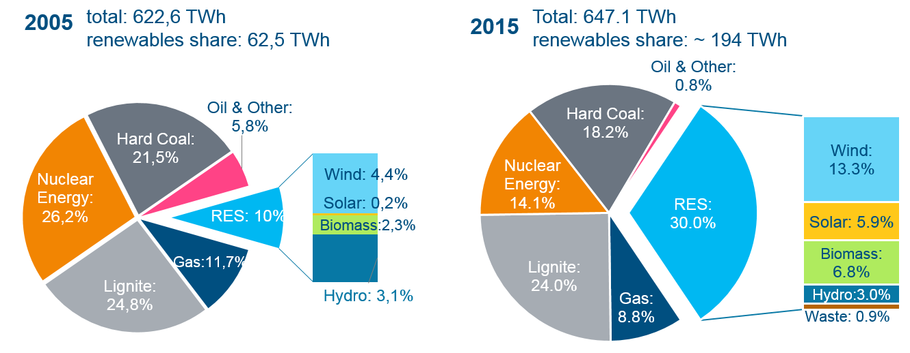
German gross electricity production
total: 622,6 TWh
renewables share: 62,5 TWh
Total: 647.1 TWh
renewables share: ~ 194 TWh
Source: Ecofys 2016, AGEB 2015, Agora Energiewende 2016
Renewables have overtaken each conventional source to become the largest electricity source in just ten years.

Slide 8
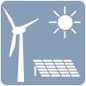
Investments in the renewable energy sector in 2016
Wind energy
(on and offshore):
€ 9.4 bn.
Total 2016:
€ 14,2 billion
Total 2016:
€ 14,2 billion
Biomass (heat and power): € 1.7 bn.
Photovoltaic: € 1.6 bn.
Geothermal: € 1.1 bn.
Solar thermal + CSP: € 0,8 bn.
Hydropower: € 0.3 bn.
Investments in renewable energy installations amounted to over €14 billion in 2016.
Source: AGEE-Stat /UBA 2017
Notes:
BASIC
The slide illustrates investments in construction of renewable energy installations in 2014 in Germany in billion Euro.
Bar sizes are not to scale, just illustrative!
Also here wind power has turned into the most important sector of investment activity in Germany.
Beyond, German wind turbine manufacturers and component suppliers are major players on the international markets.
Total investments amounted to € 14.5 in 2015 (€18.8 billion in 2014)
Wind energy: € 9.7 bn. (€12.3 billion in 2014)
PV: € 1.5 bn. (€2.3 billion in 2014)
Biomass electricity: € 0.5 bn. (€1.3 billion in 2014)
Biomass heat (inlcuding biogas): € 1.0 bn. (€1.3 billion in 2014)
Solar thermal and CSP: € 0.8 bn. (€0,8 billion (CSP only technology providers, and manufacturers. There is only one CSP test plant in research Centre Jülich)
Geothermal and heat pumps: € 1.0 bn. (€1.0 billion in 2014)
Hydropower: € 0.1 bn. (€0.1 billion in 2014)
Source
AGEE-Stat/UBA 2017: Hintergrund: Erneuerbare Energien in Deutschland, Daten zur Entwicklung im Jahr 2016, März 2017,
https://www.umweltbundesamt.de/sites/default/files/medien/376/publikationen/erneuerbare_energien_in_deutschland_daten_zur_entwicklung_im_jahr_2016.pdf

Slide 9
Benefits of the Energiewende
The energy transition has numerous positive effects on various levels.
Source: BMWi 2014, ERGO Kommunikation
Notes:
BASIC
The slide visualizes the diverse and multi-fold macroeconomic effects of energy transition (Energiewende) in Germany.
The development of renewable energy technologies, services and products such as renewable electricity as well as energy efficiency technologies, services and products used by end consumers have effects on several factors such as
Avoided energy imports: The substitution of fossil fuels imports (oil, gas, coal) to Germany by renewable energy use saves money. In 2013 renewables saved energy imports worth 9,1 billion euros.
Increased security of supply due to reduced exposure to volatile world prices and less dependence on non-democratic regimes (=reduced geopolitical hazard)
Environmental protection (lower emissions and less pollutants
positive employment effects in the renewables and energy efficiency sectors, which outweigh negative effects in the conventional energy sector.
Innovation triggering: Germany is establishing a green economy based on new products, services and new companies that lead to
an increase in regional added value via turnover and economic activities by and for local actors.
All these factors constitute the macro-economic effects presented here.
Reduced external costs/ higher external benefits (e.g. emission reductions) from renewables or energy efficiency are usually not accounted for by macro-economic models leading to a systemic bias in favour of traditional energies and their use.
Source
Visualisation: ergo-kommunikation based on IZES, Fraunhofer ISI, DIW Berlin and GWS 2010: „Einzel- und gesamtwirtschaftliche Analyse von Kosten- und Nutzenwirkungen des Ausbaus Erneuerbarer Energien im deutschen Strom- und Wärmemarkt“ http://www.erneuerbare-energien.de/fileadmin/eeimport/files/pdfs/allgemein/application/pdf/endbericht_ausbau_ee_2009.pdf, last accessed May 2015.

Slide 10
Gross job creation in the German renewables sector
Source: BMWi - DLR/DIW/GWS 2015
The renewables sector has positive employment effects in Germany.

Slide 11
Gross job creation in the German renewables sector
Source: BMWi - DLR/DIW/GWS 2015
The renewables sector has positive employment effects in Germany.

Slide 12
New patents for renewable energy in Germany 2005-2014
Source: Statista 2016
The energy transition is a driver for innovation.

Slide 13
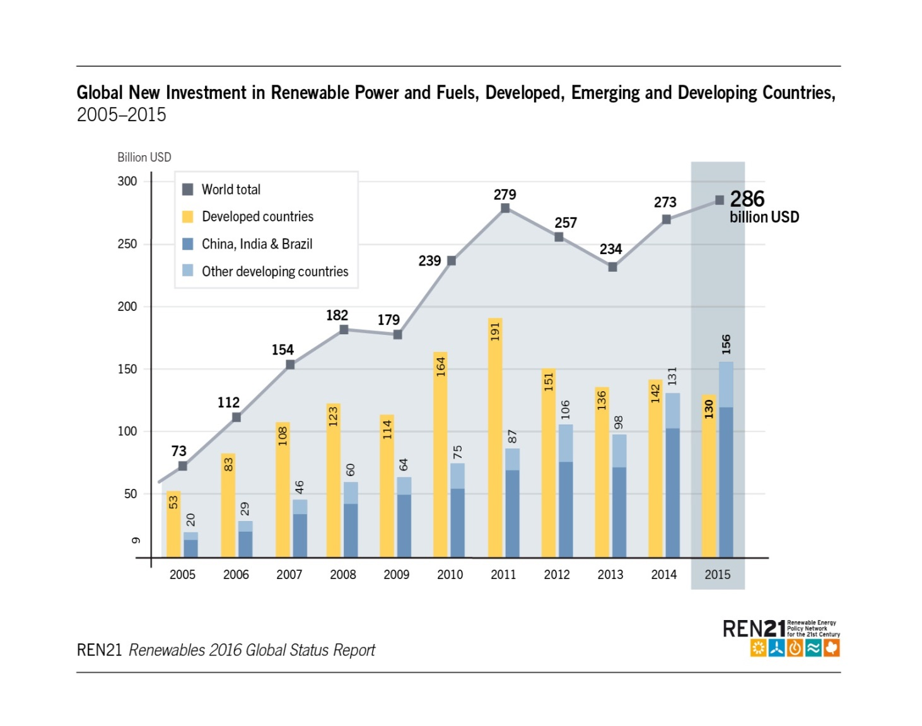
Global Investment in Renewable Energy
Global new investment in renewables estimated at USD 286 billion in 2015
A new record high
Increase of 5% from 2014
Including hydropower: USD 328.9 billion
Notes:
Global new investment in renewable power and fuels climbed to a record USD 285.9 billion in 2015 (not including hydropower projects >50 MW), as estimated by Bloomberg New Energy Finance (BNEF). This represents a rise of 5% compared to 2014 and exceeds the previous record (USD 278.5 billion) achieved in 2011.
Including investments in hydropower projects larger than 50 MW, total new investment during 2015 in renewable power and fuels (not including renewable heating and cooling) was at least USD 328.9 billion.
In 2015, global investment in new renewable power capacity, at USD 265.8 billion, was more than double the USD 130 billion allocated to new coal- and natural gas-fired power generation capacity. This difference in favour of renewables is the largest witnessed to date. If hydropower projects larger than 50 MW are considered, the spread between renewables and fossil fuel investment in new power capacity is even greater.

Slide 14
Global Investment in Renewable Energy
Developing & emerging countries:
USD 156 billion
Increase of 19% compared to 2014
Developed countries:
USD 130 billion
Decrease of 8% compared to 2014
Notes:
In 2015, for the first time in history, total investment in renewable power and fuels in developing countries exceeded that in developed economies. The developing world, including China, India and Brazil, committed a total of USD 156 billion (up 19% compared to 2014). China played a dominant role, increasing its investment by 17% to USD 102.9 billion, accounting for 36% of the global total. Renewable energy investment also increased significantly in India, South Africa, Mexico and Chile. Other developing countries investing more than USD 500 million in renewables in 2015 included Morocco, Uruguay, the Philippines, Pakistan and Honduras.
By contrast, renewable energy investment in developed countries as a group declined by 8% in 2015, to USD 130 billion. The most significant decrease was seen in Europe (down 21% to USD 48.8 billion), despite the region’s record year of financing for offshore wind power (USD 17 billion, up 11% from 2014). In the United States, renewable energy investment (dominated largely by solar power) increased by 19%, the country’s largest increase since 2011.

Slide 15
Jobs in Renewable Energy
Global employment continued to increase by 5% in 2015
An estimated 8.1 million direct and indirect jobs in the renewable energy industry
Leading employers in 2015 were China, Brazil, the United States, and India
Notes:
Employment in the renewable energy sector increased by 5% in 2015, to an estimated 8.1 million jobs (direct and indirect), as estimated by the International Renewable Energy Agency (IRENA).
Solar PV and biofuels provided the largest numbers of renewable energy jobs. Large-scale hydropower accounted for an additional 1.3 million direct jobs.
Considering all renewable energy technologies, the leading employers in 2015 were China, Brazil, the United States and India.

Slide 16
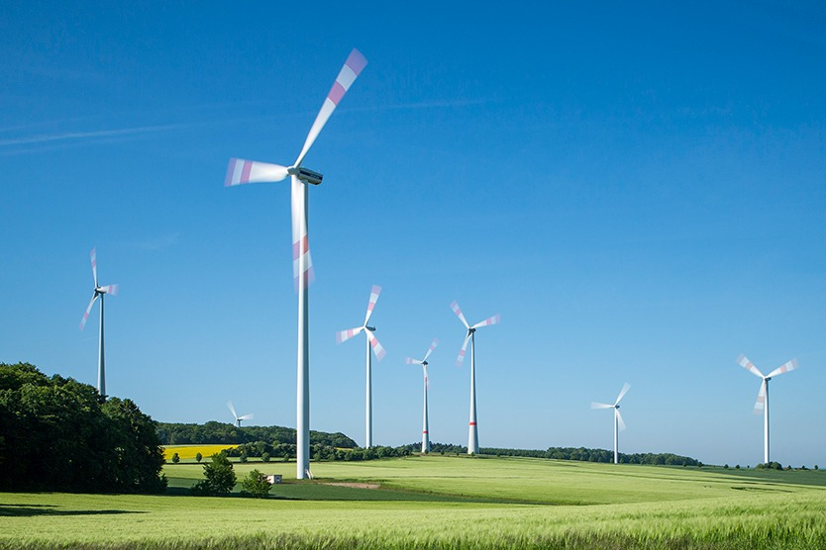
Thank you for your attention !
German Embassy, Moscow
Ellen von Zitzewitz
www.bmwi.de

